Slide 1
WEB SERVERS AND PROTOCOLS

Slide 2


MICHAL WYSZOWSKI
DevOps Engineer
Graduated SIT Academy (Propulsion) in February 2021 - batch 14
Linkedin

Slide 3

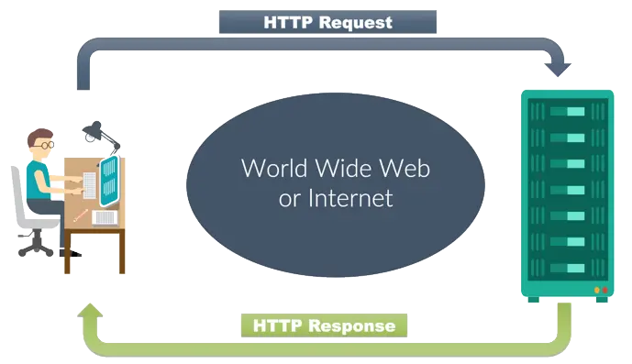
BASIC FUNCTIONALITY
Clients and Servers
The so-called “client-server model” is the most common way of how distributed systems are structured. In this model, a client usually requests a specific resource (e.g. website, pictures, music) from a server.
Clients and servers typically communicate over a computer network such as the internet, and thus run on different hardware.
In the typical client-server model, the client sends a request for a service and a server performs that service and sends a response. There is a wide variety of services, such as getting a webpage, downloading a picture, uploading some files, but also updating your profile, posting a new tweet, etc.

Slide 4
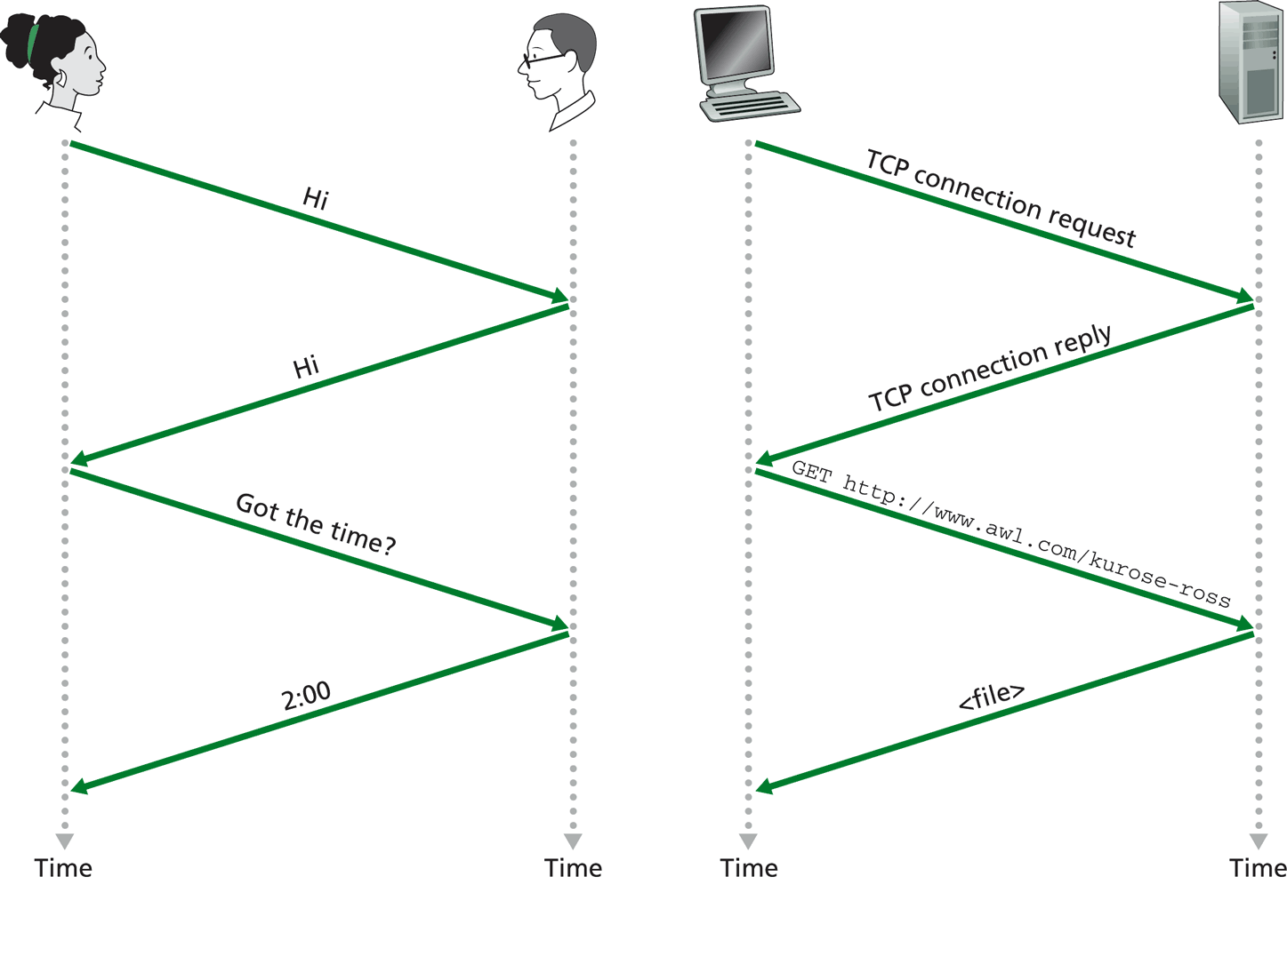
PROTOCOLS
A network protocol is an established set of rules that determine how data is transmitted between different devices in the same network. Essentially, it allows connected devices to communicate with each other, regardless of any differences in their internal processes, structure or design. Network protocols are the reason you can easily communicate with people all over the world, and thus play a critical role in modern digital communications. Network protocols include mechanisms for devices to identify and make connections with each other, as well as formatting rules that specify how data is packaged into messages sent and received.

Slide 5
PROTOCOLS
TCP/IP (Transmission Control Protocol) is one of the basic underlying transport protocols in heterogeneous, distributed system such as the internet. It stands for Transmission Control Protocol and Internet Protocol. It is a connection-oriented protocol. TCP/IP basically defines how data travels from a sender across the web to a receiver. Send bits of data known as packets. TCP is the most commonly used protocol on the Internet. TCP is all about reliability—packets sent with TCP are tracked so no data is lost or corrupted in transit. This is why file downloads don’t become corrupted even if there are network hiccups. TCP achieves this in two ways. First, it orders packets by numbering them. Second, it error-checks by having the recipient send a response back to the sender saying that it has received the message. If the sender doesn’t get a correct response, it can resend the packets to ensure the recipient receives them correctly. Three-Way Handshake: The first message is the SYN or Synchronize message, request to make connection. The server will reply back, if it is available, with a SYN/ACK or Synchronize/Acknowledge message. This means that the port on the server is open and available for connection. If the server is not available, it will timeout and no connection will be established. The client will receive the SYN/ACK data packet and reply back to the server with the ACK or Acknowledge message. A communications channel is then established and the client can now connect to the server to transmit and receive data.
UDP (User Datagram Protocol) is a communications protocol that is primarily used to establish low-latency and loss-tolerating connections between applications on the internet. UDP speeds up transmissions by enabling the transfer of data before an agreement is provided by the receiving party. The UDP protocol works similarly to TCP, but it throws out all the error-checking stuff. When an app uses UDP, packets are just sent to the recipient. The sender doesn’t wait to make sure the recipient received the packet—it just continues sending the next packets. UDP is used when speed is desirable and error correction isn’t necessary. For example, UDP is frequently used for live broadcasts and online games.
HTTP (Hypertext Transfer Protocol) is an application-layer protocol for transmitting hypermedia documents, such as HTML. It was designed for communication between web browsers and web servers. It is built upon TCP as transport medium. HTTP is the primary protocol for transmission of information across the Internet. HTTP is usually used to download websites from the internet into a web browser. However, is not limited to this and is also widely used as a general file transfer protocol.

Slide 6
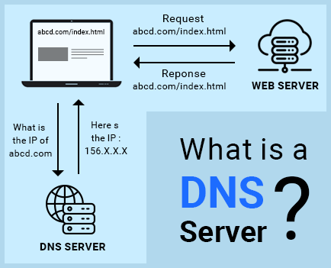
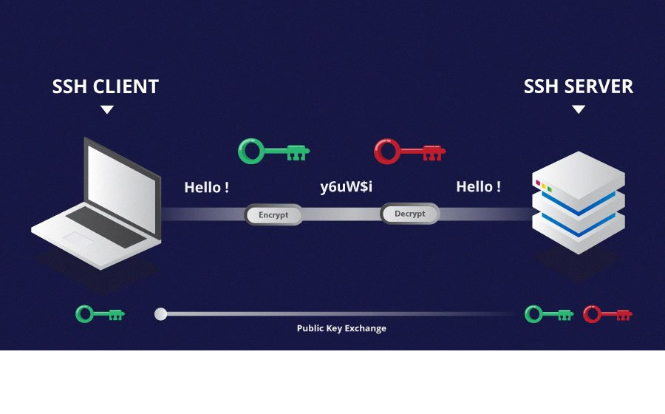
PROTOCOLS
DNS (The Domain Name System) All computers on the Internet, from your smart phone or laptop to the servers that serve content for massive retail websites, find and communicate with one another by using numbers. These numbers are known as IP addresses. When you open a web browser and go to a website, you don't have to remember and enter a long number. Instead, you can enter a domain name like example.com and still end up in the right place. A DNS service such as AWS Route 53 is a globally distributed service that translates human readable names like www.example.com into the numeric IP addresses like 192.0.2.1 that computers use to connect to each other. The Internet’s DNS system works much like a phone book by managing the mapping between names and numbers. DNS servers translate requests for names into IP addresses, controlling which server an end user will reach when they type a domain name into their web browser. These requests are called queries.
SSH (Secure Shell) Secure Shell is network protocol for secure connections to another computer. It is usually used to connect to a remote computer or server and to open a terminal on that computer. This means, that you can execute commands on a shell on that server, e.g. to execute code or to install new software. SSH is commonly used on port 22. It uses TCP as the transport medium.

Slide 7
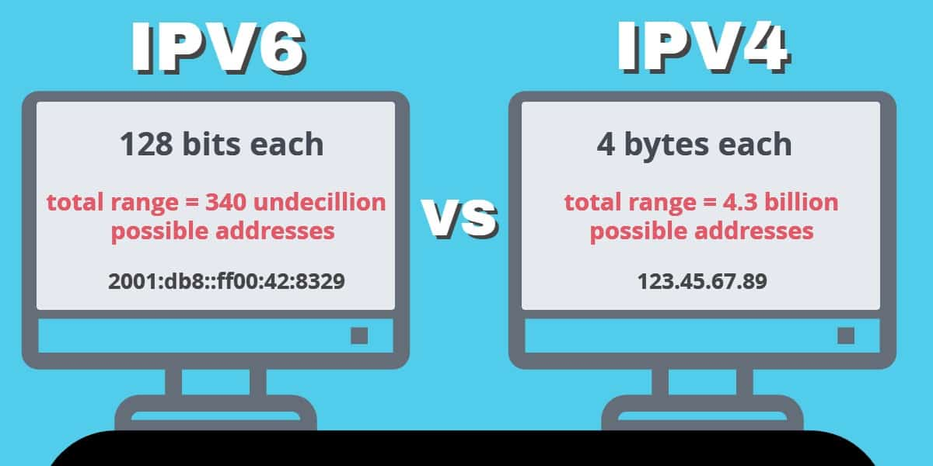
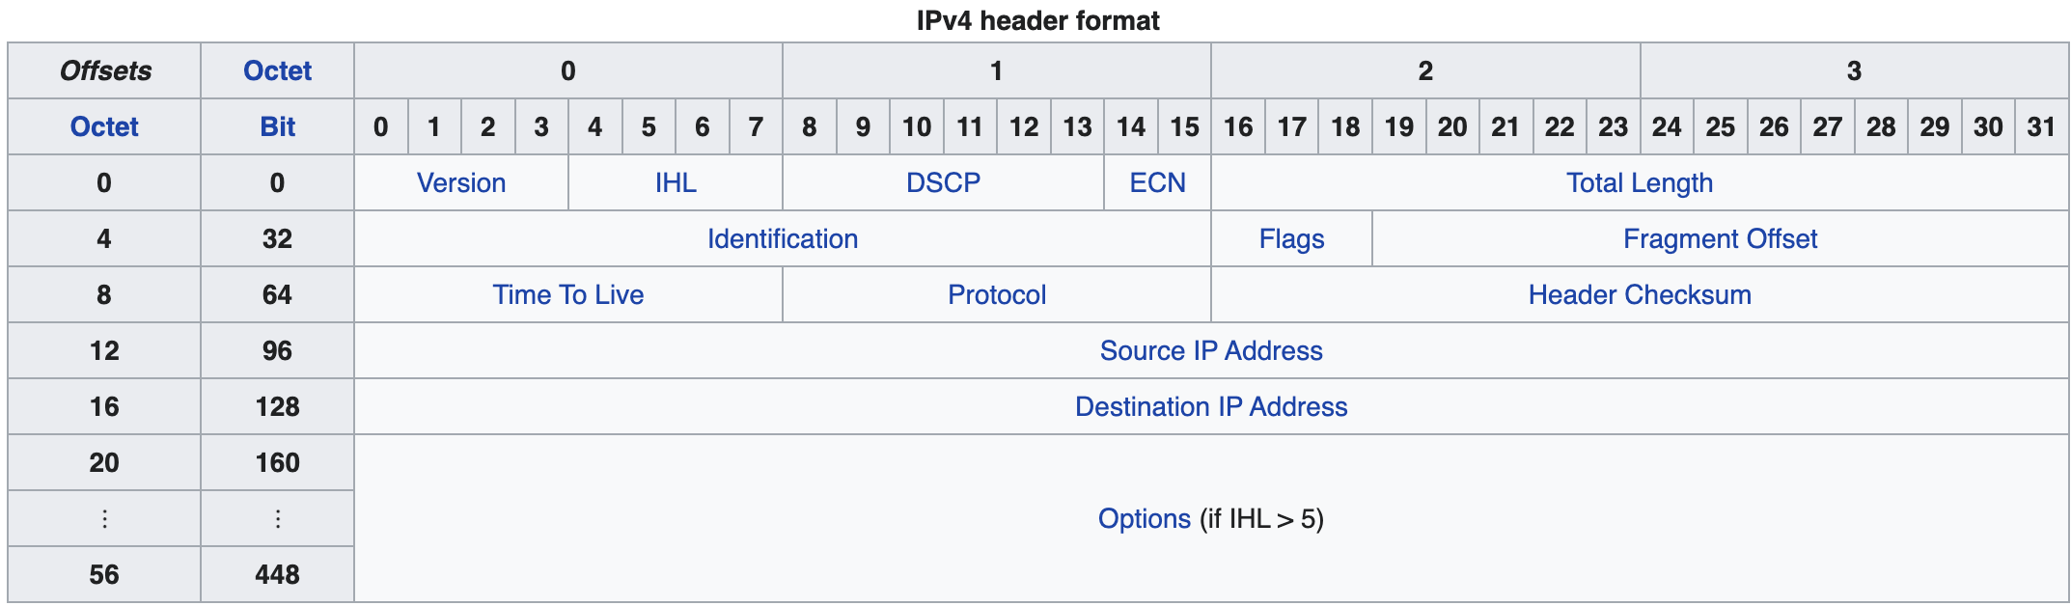
IP ADDRESSES AND PORTS
An IP address is a unique address that identifies a device on the internet or a local network. IP stands for "Internet Protocol," which is the set of rules governing the format of data sent via the internet or local network. In essence, IP addresses are the identifier that allows information to be sent between devices on a network: they contain location information and make devices accessible for communication. The internet needs a way to differentiate between different computers, routers, and websites. IP addresses are not random. They are mathematically produced and allocated by the Internet Assigned Numbers Authority. Most of the larger websites like Apple has it’s own IP address. Smaller websites may share single server address amongst hundreds of other websites. On the other hand, the websites and apps also can track your details based on your IP address. Let us take the same example of accessing Apple’s website. When you open the site from China, it will automatically redirects to the Chinese version applce.com/cn/ instead of the English version apple.com. This indicates that Apple can detect the geo location of the user and serve different content for different users. For the most part, an IP address tells you the city, ZIP code, or area code of your ISP, as well as your ISP's name.
Port In computer networking, a port is a number assigned to uniquely identify a connection endpoint and to direct data to a specific service. At the software level, within an operating system, a port is a logical construct that identifies a specific process or a type of network service. Think of IP address as the address of your house, and the port being the number of door through which to enter. Door number 80 for example would lead you to a website.

Slide 8
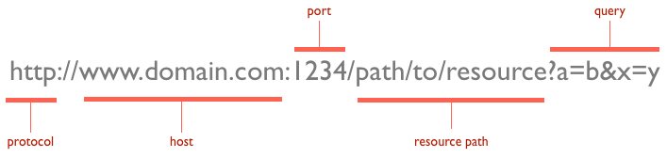
HTTP REQUESTS
An HTTP request is made by a client, to a named host, which is located on a server. The aim of the request is to access a resource on the server. To make the request, the client uses components of a URL (Uniform Resource Locator), which includes the information needed to access the resource. Communication between a host and a client happens via a request/response pair, request: message containing a request or question from the client, sent to the server, response: message containing the answer from the server, sent back to the client.
URLS (Uniform Resource Locator) is a unique identifier used to locate a resource on the Internet. It is also referred to as a web address. URLs consist of multiple parts -- including a protocol and domain name -- that tell a web browser how and where to retrieve a resource. The protocol is typically http, but it can also be https for secure communications. The default port is 80, but one can be set explicitly, as illustrated in the above image. The resource path is the local path to the resource on the server.

Slide 9
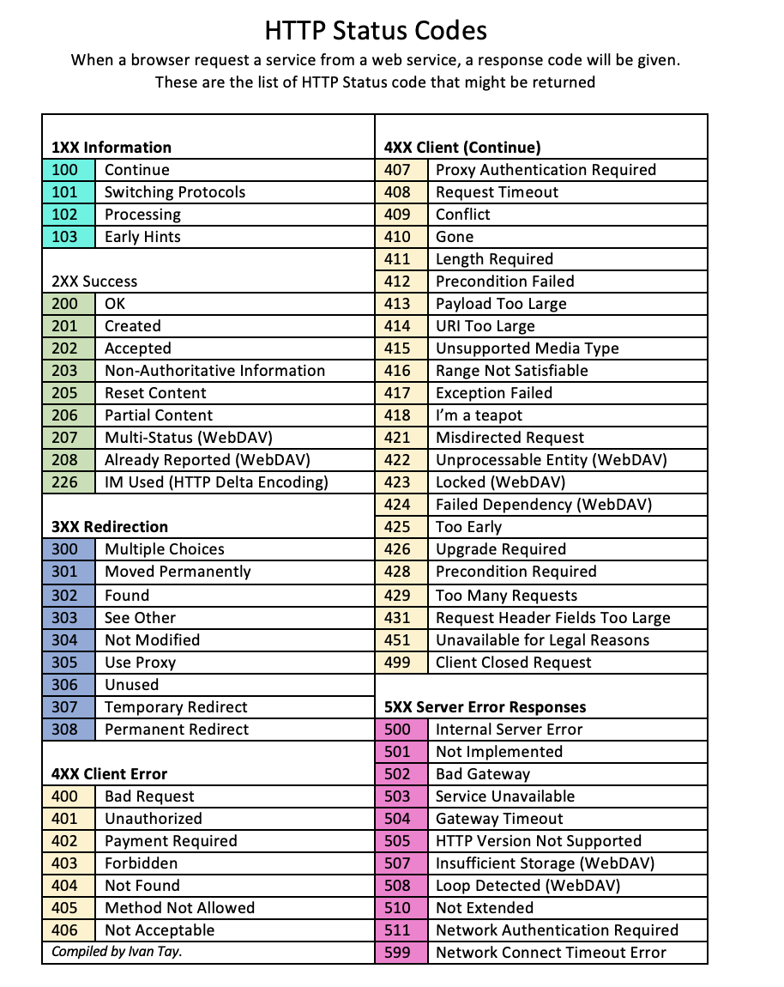


HTTP STATUS CODES

Slide 10
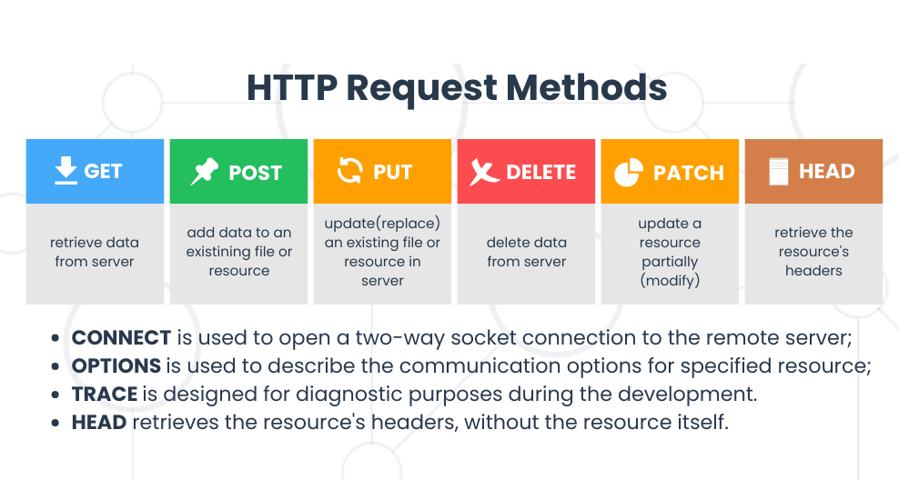
HTTP REQUEST METHODS
URLs describe which host we would like to communicate with, and which path on that host we are interested in, but it might not be clear what has to be performed at this address. To address that issue, HTTP introduced several request methods that define what should happen with each call.

Slide 11
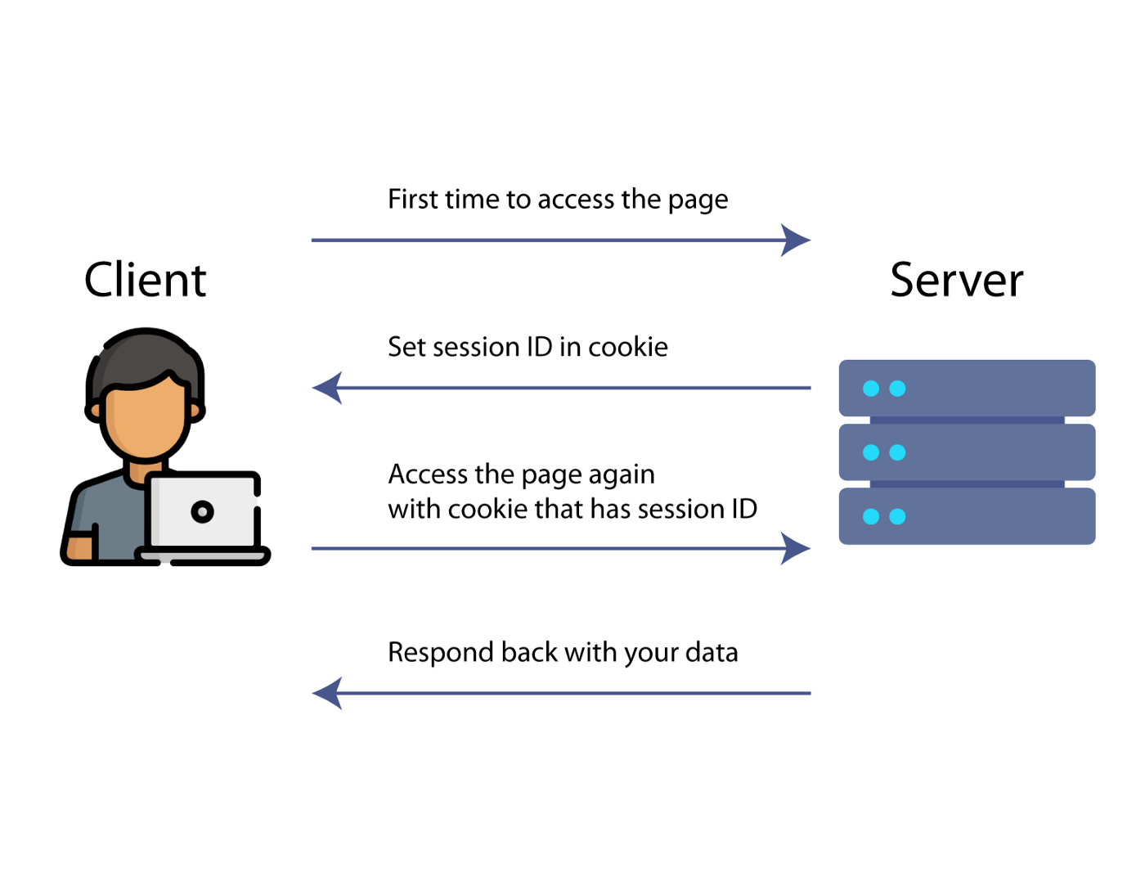
HTTP
HTTP-Header (for short header) contains information about the content being sent, for example the encoding, content-type, cookies, custom headers, etc. This information is used to by the client or server to interpret the content. Note that both request and response can have different headers.
HTTP-Cookie is used to store website or domain specific information for a limited time on a clients browser. These cookies can get exchanged back to the server on request. It is kind of a way to store data or session information across multiple HTTP requests (remember, HTTP is otherwise stateless). The place where this Cookies getting exchanged is the HTTP-Header of a request or response message. Usage: language, session id, application functionality. Every cookies has an expire date and time value sent from the sever and stored in the client.
Session on the web is the time frame when a user gets authenticated in any way until they perform a logout or get logged out after a given time has passed. To prevent a user from entering a username and a password for every request their browser performs we can make use of a browser data storage like cookies.Cookies can be used to store a Session-ID of a user. This ID is generated when this user authenticates themselves on a website and sent with the response header section. When the browser receives this header, it stores it for this domain.

Slide 12

Curl is a useful command line tool to transfer data to or from a server. It is super useful to see what happens on HTTP requests. curl is used in command lines or scripts to transfer data. curl is also used in cars, television sets, routers, printers, audio equipment, mobile phones, tablets, settop boxes, media players and is the Internet transfer engine for thousands of software applications in over ten billion installations.
Curl support: DICT, FILE, FTP, FTPS, GOPHER, GOPHERS, HTTP, HTTPS, IMAP, IMAPS, LDAP, LDAPS, MQTT, POP3, POP3S, RTMP, RTMPS, RTSP, SCP, SFTP, SMB, SMBS, SMTP, SMTPS, TELNET and TFTP. curl supports SSL certificates, HTTP POST, HTTP PUT, FTP uploading, HTTP form based upload, proxies, HTTP/2, HTTP/3, cookies, user+password authentication (Basic, Plain, Digest, CRAM-MD5, SCRAM-SHA, NTLM, Negotiate and Kerberos), file transfer resume, proxy tunneling and more.
Examples:
curl -I -inspect header(/%)
curl > download website to html file
curl -O -download website, images from web to a file
curl -u michal:123 HTTP://hello download with auth
curl -L redirect if 300

Slide 13
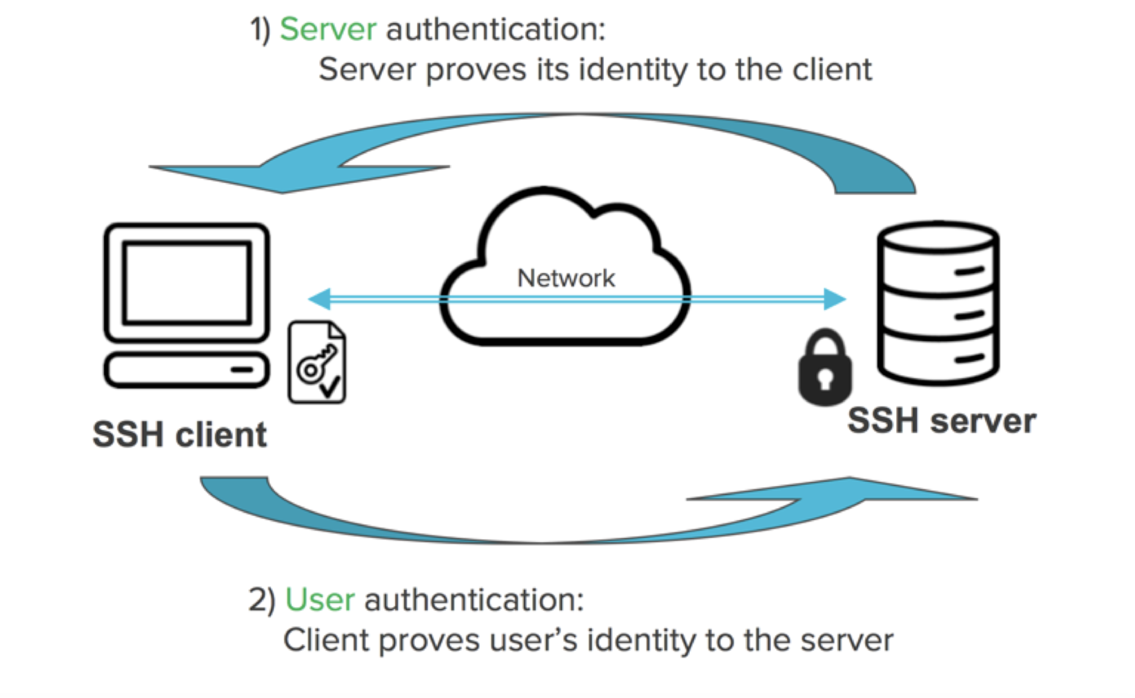
SSH AND LINUX BASIC COMMANDS
Most useful commands:
pwd - print working directory
ls - list files
cd - change directory
touch - create file
mkdir - create folder
mv - move, rename file/directory
cp - copy file/directory
SSH key is a secure access credential used in the Secure Shell (SSH) protocol. SSH keys use key pairs based on public key infrastructure (PKI) technology, the gold standard for digital identity authentication and encryption, to provide a secure and scalable method of authentication.
Private key is used for both encrypting and decrypting the sensitive data. It is shared between the sender and receiver of encrypted data. Public key is used only for the purpose of encrypting the data.

Slide 14
SSH
Public SSH-Key Authentication
Instead of passing username and password, this method uses an SSH key pair for authentication. The benefit of this is that you do not have to enter your password every single time. Generally it is also considered to be more secure than passwords. SSH key pairs are nothing other than an RSA key pair. RSA was one of the first asymmetric cryptographic approaches. In a nutshell, it is based on the following principle:
Each RSA consists of two keys, a private key and a public key.
Both keys can be used to encrypt messages.
the private can be used to decrypt, i.e. read messages
SSH key pairs can be used to log in into a server without a password.
First, you will have to create a public and private RSA key pair (ssh-keygen) This will ask you for enter a password to encrypt your ssh key. It’s a second security layer to prevent someone from stealing your private key and login to servers without a password.
Second, you take the public key and store it on the server. From that point on, the server knows that you are allowed to log in with this key.
Then, when ssh’ing into a machine, the server will use your public key to open a secure connection.
While log in to the server you will be asked to store the IP address of this server and its ECDSA key fingerprint on your computer to prevent network manipulations. This fingerprint is unique, and can be used to make sure you always connect to the same server.

Slide 15
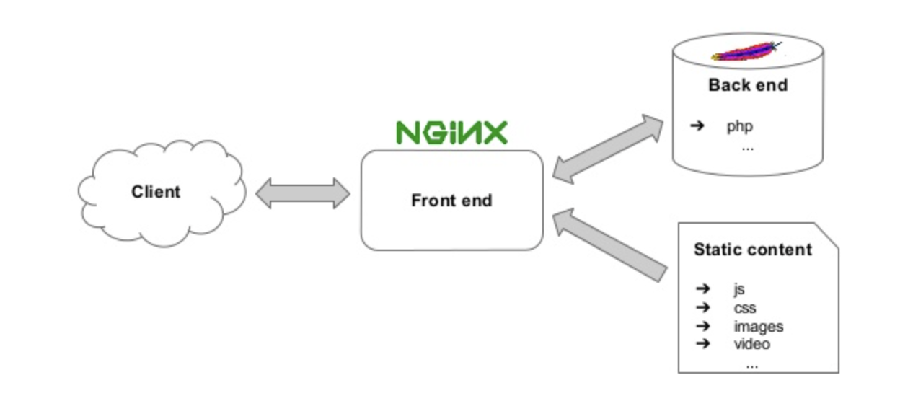
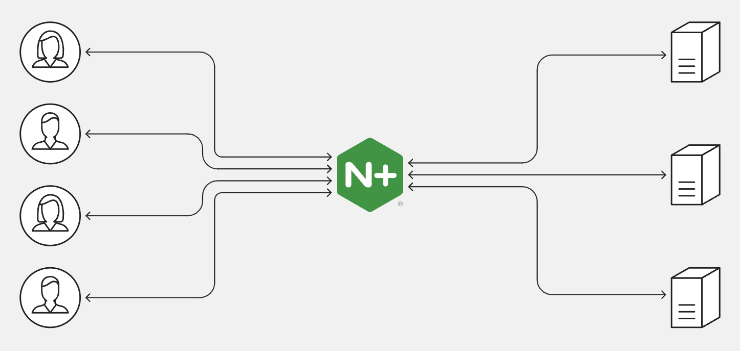
NGINX
NGINX is open source software for web serving, reverse proxying, caching, load balancing, media streaming, and more. It started out as a web server designed for maximum performance and stability. NGINX also helps in setting up a secured connection between your data-centres and the outside network. It also works well as an HTTP load balancer that allows you to use multiple different load-sharing mechanisms. The basic Nginx architecture consists of a master process and its workers. The master is supposed to read the configuration file and maintain worker processes, while workers do the actual processing of requests. Because Nginx is asynchronous, each request can be executed by the worker concurrently without blocking other requests.

